Slide 1


Slide 2
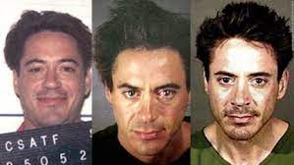

Slide 3
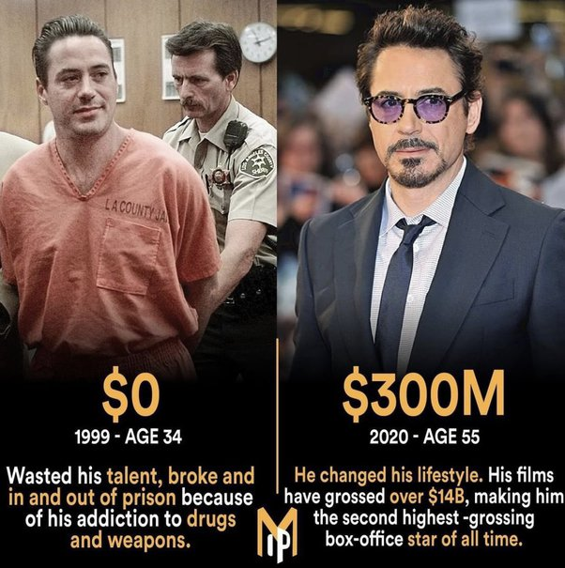
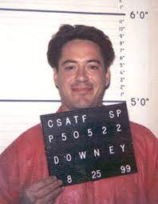

Slide 4
Mano Guru
Your every visit is very precious to us.
We love to serve you delicious food and your desired drinks.
You can avail our monthly membership card after your third visit .

Slide 5
We offer you many exciting incentives on availing our membership, some of them being :
Points will be added on your every visit to our salad bar
You will be receiving a Appreciation Certificates from our side on completion of 500 points. You can definitely show-off this certificate on social media
We will be making donations on your prefered name after completion of 5000 points
Donations will be made to Rehabilitation Centres on the behalf of our initiative “Mano Guru”
You will be receiving our Gratitude certificates from our side after the donation is made

Slide 6
“Mano Guru,
Your Social Companion”
Our social initiative which includes a six months counselling program for our employees working at the salad bar. This initiative focuses on the problem of social integration of people entering the society after rehabilitation or social isolation . This program helps them getting a job after working six months at our salad bars.
We provide them accommodation for this period of six months. The salad bar collaborates with many projects in Lithuania and worldwide. In 2009-10, the salad bar was recognised as the most hospitable cafe in Vilnius. We partner with many firms in Lithuania and worldwide to promote our social initiative.

Slide 7
“Mano Guru” are members of National Network of Poverty Alleviation Organizations and Lithuanian Social Business Association.
Since our establishment in 2004, the salad bar “Mano Guru” has helped over 800 people escape their troubled environments and start an independent, addiction-free lifestyle.
We also have a food truck that has been invited to a event and we further aim to expand the customer base and the popularity of the food truck .
We further aim to boost our business of salad bar, banquets and buffets.

Slide 8
We aim to promote this social initiative in the society by :
We plan on expanding our presence over all social media platforms
We will be uploading multiple videos of how our employees contribute towards the betterment of the society
We would request well-known people who have undergone rehabilitation to urge the society to accept the rehabilitated people and explain the importance of why they should be accepted in the society
People visiting our salad bar, buffets and banquets are definitely contributing in bettering the lives of our employees
This social initiative also includes the employees of the salad bar performing selfless actions towards the society like helping the poor and needy, feeding the hungry etc.

